Slide 1
SyNtax Analysis
Chapter-4(Last Part)

Slide 2
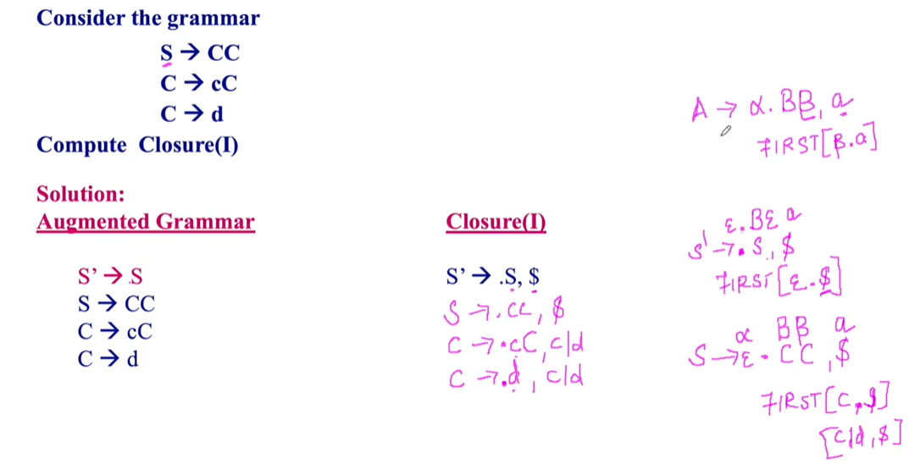
Compute closure(I) for clr/lalr

Slide 3
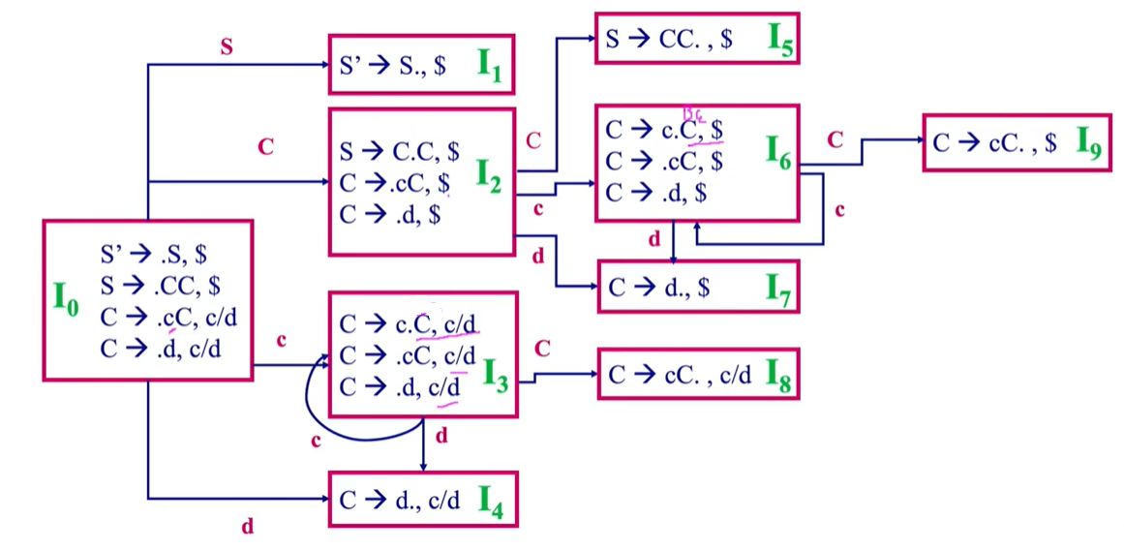
Coumpute lr(1) Automaton

Slide 4
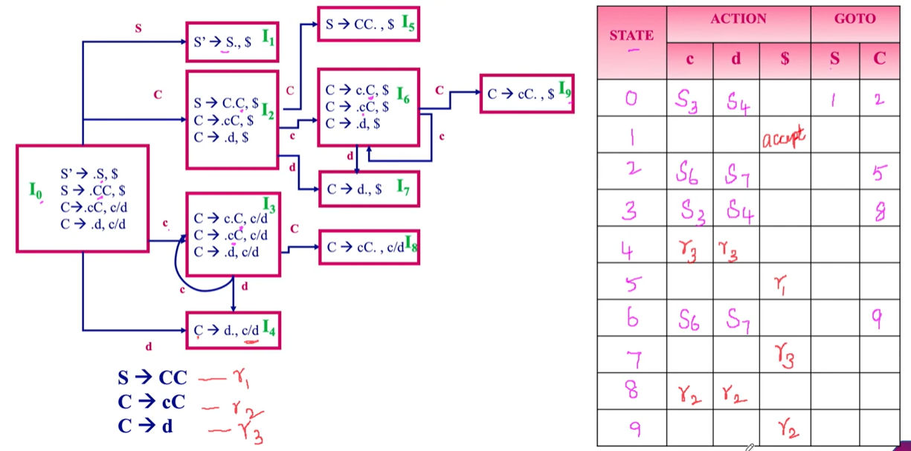
construct clr parsing table

Slide 5
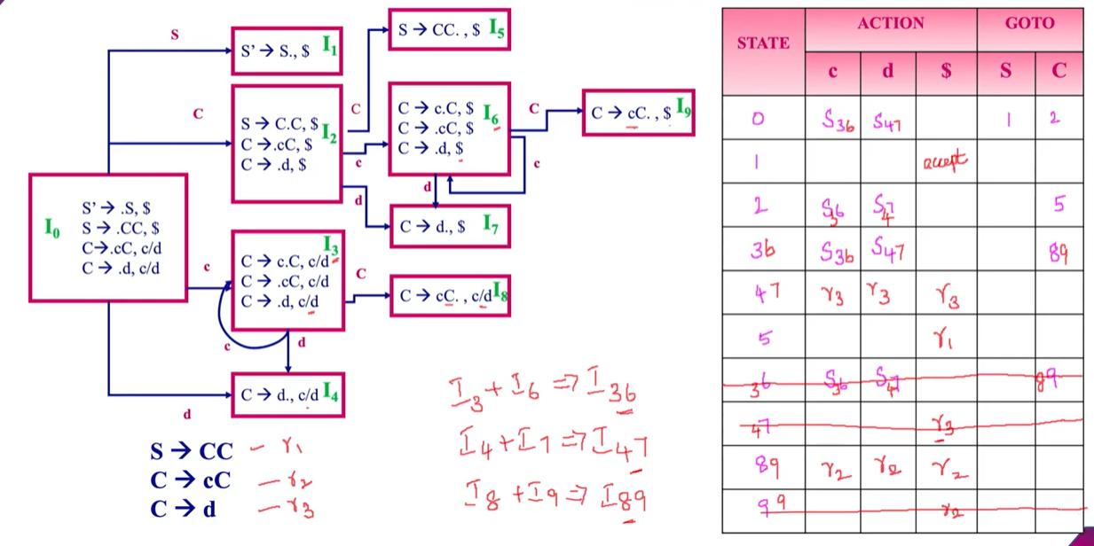
Construct Lalr parsing table

Slide 6
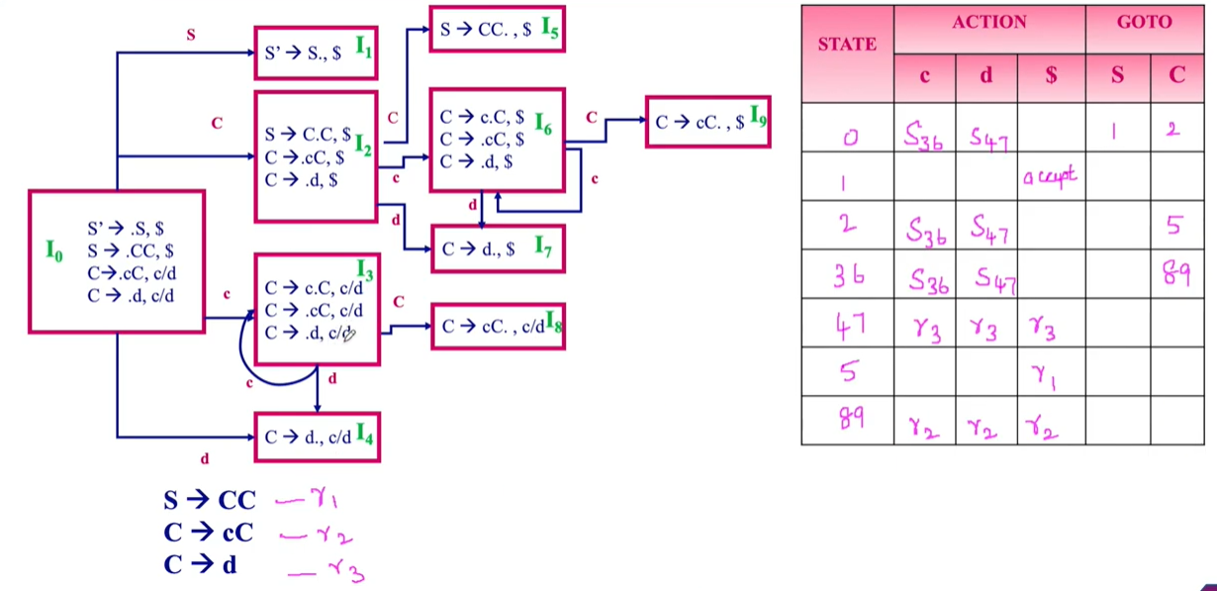
Construct Lalr parsing table (Contd.)

Slide 7
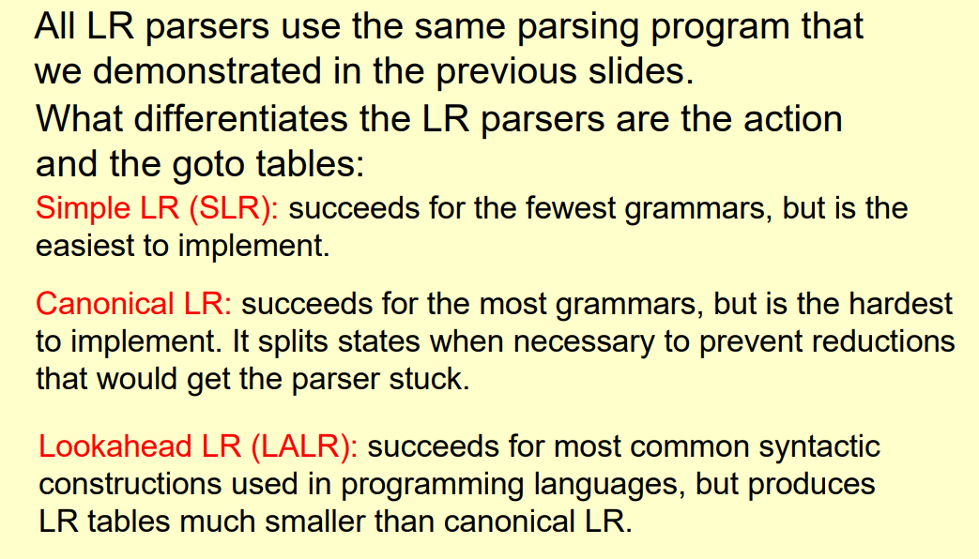
Differentiate Among LR parsers

Slide 8
LL, SLR, LR, LALR Summary
LL parse tables computed using FIRST/FOLLOW
Nonterminals × terminals → productions
Computed using FIRST/FOLLOW
LR parsing tables computed using closure/goto
LR states × terminals → shift/reduce actions
LR states × nonterminals → goto state transitions
A grammar is
LL(1) if its LL(1) parse table has no conflicts
SLR if its SLR parse table has no conflicts
LALR if its LALR parse table has no conflicts
LR(1) if its LR(1) parse table has no conflicts

Slide 9
LL, SLR, LR, LALR Grammars
LR(1)
LL(1)
LALR
SLR
LR(0)

Slide 10
Thank You!!!!

